Slide 1



Mediation in Patent Matters
Dr. Tobias Wuttke, UPC Representative, Bardehle Pagenberg PartG mbB

Slide 2
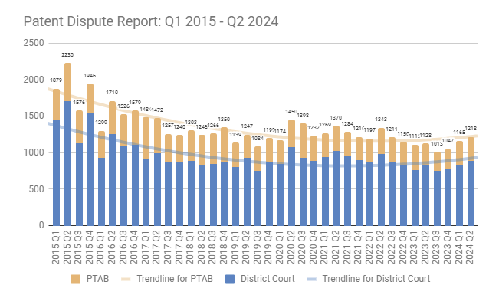
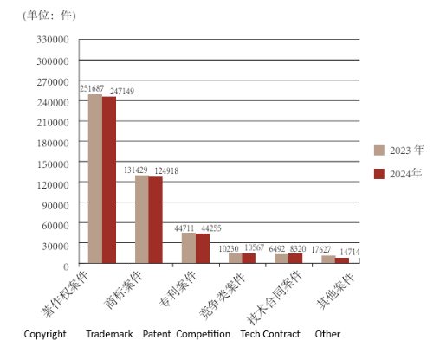
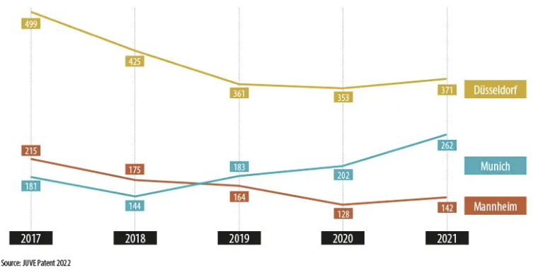
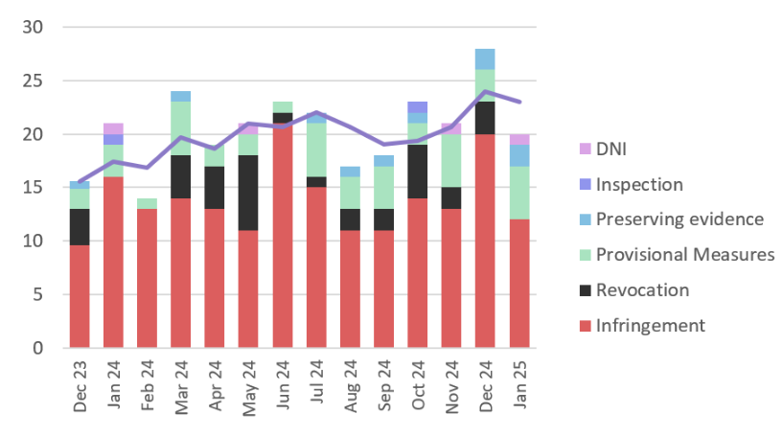
Patent Litigation U.S. – China – UPC – Germany
U.S.:
China:
Data Source: Supreme People‘ Court
Patent Dispute Report: 2024 Mid-Year Report — Unified Patents
Germany:
UPC:
UPC Statistics: 60% Success Rate Patentees, Rapid, and Further Key Insights - JUVE Patent

Slide 3
Patent infringement
UPCA as example
Article 25 – Right to prevent the direct use of the invention
Patent owner can stop others from:
Making/offering/using/selling/importing/storing a patented product
Using/offering a patented process
Offering/selling/using/importing/storing a product obtained by a patented process
Article 26 – Right to prevent the indirect use of the invention
Patent owner can stop others from:
Supplying/offering to supply means related to essential elements of the invention, if intended for (or suitable for) implementing it.
It applies when the third party knows, or should know, that such means will be used to put the invention into effect

Slide 4

Growing relevance of ADR and especially Mediation
Origins of ADR and development in the U.S. since the 1970s
  Not mandatory, but widely recognised (e.g. mediation clauses in contracts)
  Development of combinations like “Med/Arb”
    Party agreement in advance: mediation first, but if unresolved, proceeding with a binding arbitration, with the mediator as their arbitrator
  Mediation can also be required or ordered by courts (e.g. New York courts, the Second Circuit Court of Appeals and many others, which have procedural mechanisms for such mediations)

Slide 5
Growing relevance of ADR and especially Mediation
Growing publicity and support, including from international and European authorities and courts, e.g.:
  EU Initiatives: Mediation Directive, EUIPO Mediation Centre
  WIPO: Mediation Rules & WIPO Arbitration and Mediation Center
  FRAND Context: CJEU Huawei/ZTE judgement has led to growing recognition by authorities and courts of ADR in SEP/FRAND cases; FRAND ADR Case Management Guidelines (Munich IPDR Forum, 2018)
  Court practice (Germany): Implementation in pending litigation, e.g. Munich Regional Court I → referral to a specially trained conciliation judge possible
  UPC: Art. 35 UPCA → Patent Mediation and Arbitration Centre (PMAC) of the UPC as a specialized institution for resolving patent disputes

Slide 6
Growing relevance of ADR and especially Mediation
Mediation as a non-binding and flexible process to reach a settlement agreement universally applicable in many situations or phases of a dispute
Suitable situations for mediation in patent matters:
  Generally: after exchange of written submissions
  In particular:
    SEP/FRAND disputes/negotiations
    Lawsuits concerning the extent of damages for patent infringements
    Enforcement damages

Slide 7

Why Mediation? Significant advantages
Self-determination: choice of a neutral forum for dispute resolution
  Global IP context: globalisation & SEP/FRAND licensing → multiple jurisdictions involved
  Prevention of legal protection deficits: avoids jurisdiction in IP-problematic countries/ “home court” advantages
  Portfolio component: SEP portfolios span many patents → grounds for multi-court litigation and risk of conflicting rulings (especially outside UPC)
Mediation can cover entire SEP/patent portfolios → enables multinational resolution & prevention of future disputes
Selection of expert mediators: technical/industry-specific expertise for complex patent cases

Slide 8
Why Mediation? Significant advantages
More comprehensive & sustainable dispute resolution:
  Mediation can address complex situations, not just legal issues → incorporates perspectives beyond the case.
  Greater acceptance of the outcomes reflecting real parties’ interests (often ignored by courts) → leads to voluntary compliance, reducing need for enforcement, saving time & costs.
Forward-looking: preserves business relations & focuses on future cooperation
Confidentiality: caution required in SEP/FRAND regarding antitrust law
Costs and speed: faster and affordable especially for SMEs operating in FRAND-related disputes
Even without settlement: narrows issues & clarifies facts

Slide 9

Challenges of Mediation
Knowledge gap: limited familiarity with ADR/mediation
Outcome not binding: further court/arbitral settlement or binding agreement needed
Voluntary nature: no progress without willingness to negotiate – risk of delay tactics, trolling, misuse of information. Waste of time / cost if late termination due to long negotiations.
Mediator availability: experts not always accessible in specialised fields
No precedent value, unlike state court judgments.
Courts as alternative: proven expertise, speed, cost-efficiency (e.g. German patent courts). With UPC, another attractive option.
Suitability depends on the situation and the parties: sometimes rapid legal clarification more efficient than broad negotiations

Slide 10
Conclusion
Mediation with many upsides and growing relevance, but dependent on willingness of the parties involved
Despite support from authorities and courts, not yet sufficiently well known or accepted (partly also due to advice from attorneys)
Objective and constructive approach: should be seen as a complement to courts, not as competition
  Flexible tool in every phase of a trial, particularly in advance of a trial
  Combination possible: e.g. settlements in court following mediation / “MedArb” to achieve binding agreement
  Awareness is growing at national / EU level, but courts play a decisive role (U.S. as a role model for court-ordered mediation)

Slide 11

THANK YOU
wuttke@bardehle.de

